Slide 1
Fire Emergency Exit Hose Coupler Lighting and Communication Device
Faculty Advisor: Robin Panda
Team #238
Cody Dutko
Nick Cecchetti
Matt Locke
Notes:
NCM
Something along the lines of: Good morning. We are team 238, our project is: blah. I am blah... x3. Today we will be discussing some of the core concepts related to our design.

Slide 2
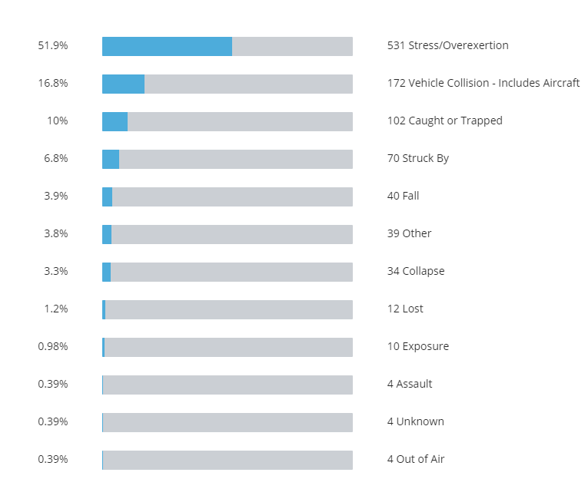
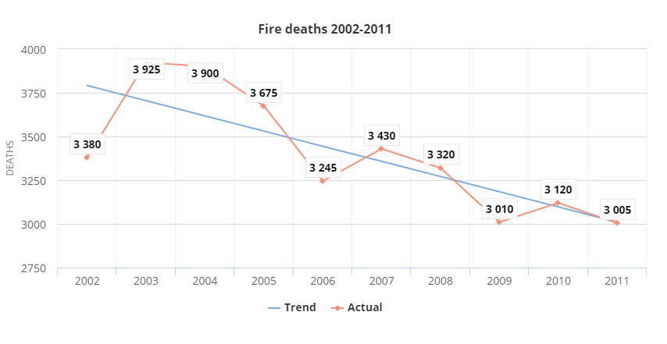
Fire Fatalities
Cause of Fatality
U.S. Fire Administration “Fire Deaths 2002-2011”
U.S. Fire Administration “Cause of Fatal Injury Jan 3, 2005 to Dec 26, 2014”
Number of On-Duty Firefighter Fatalities:1025
Notes:
C
There have been 1025 Firefighters who have died in a 9 year span. The main cause of death is stress/overexertion.
“52% of firefighters who suffered a fatal injury were volunteer firefighters”
“34% of firefighters were career fighters”
Human Factors Contributing to Fatality Percent of Fire Fatalities in Residential Buildings
Asleep 46.6%
Physical disability 26.5%
Possibly impaired by alcohol 18.2%
Thermal burns and smoke inhalation were the primary symptoms leading to death, accounting for 90 percent of all fatalities in residential fires.
Burns and smoke inhalation combined made up 46 percent of the fatalities. Smoke inhalation by itself accounted for 39 percent of residential fire fatalities and thermal burns (as opposed to scalds or chemical or electrical burns) alone accounted for 5 percent of fatalities
(Figure 4). Cardiac arrests accounted for only 3 percent of fatalities. Thermal burns are caused by contact with flames, hot liquids, hot surfaces, and other sources of high heat. Multiple body parts were involved in 86 percent of thermal burn fatalities.
http://www.usfa.fema.gov/downloads/pdf/statistics/v16i2.pdf
Why don’t these reports include statistics from 2014 to the present?
Our reports reflect the most current data available at the time of analysis. In priority order, we primarily rely on these data sources:
National Fire Incident Reporting System incident-level data 10 to 18 months after the end of the calendar year
National Center for Health Statistics vital records Two plus years after the end of the calendar year
National Fire Protection Association survey estimates Nine months after the end of the calendar year
The deaths caused by fires has been declining over the years, but it may be possible to eliminate even more death.

Slide 3
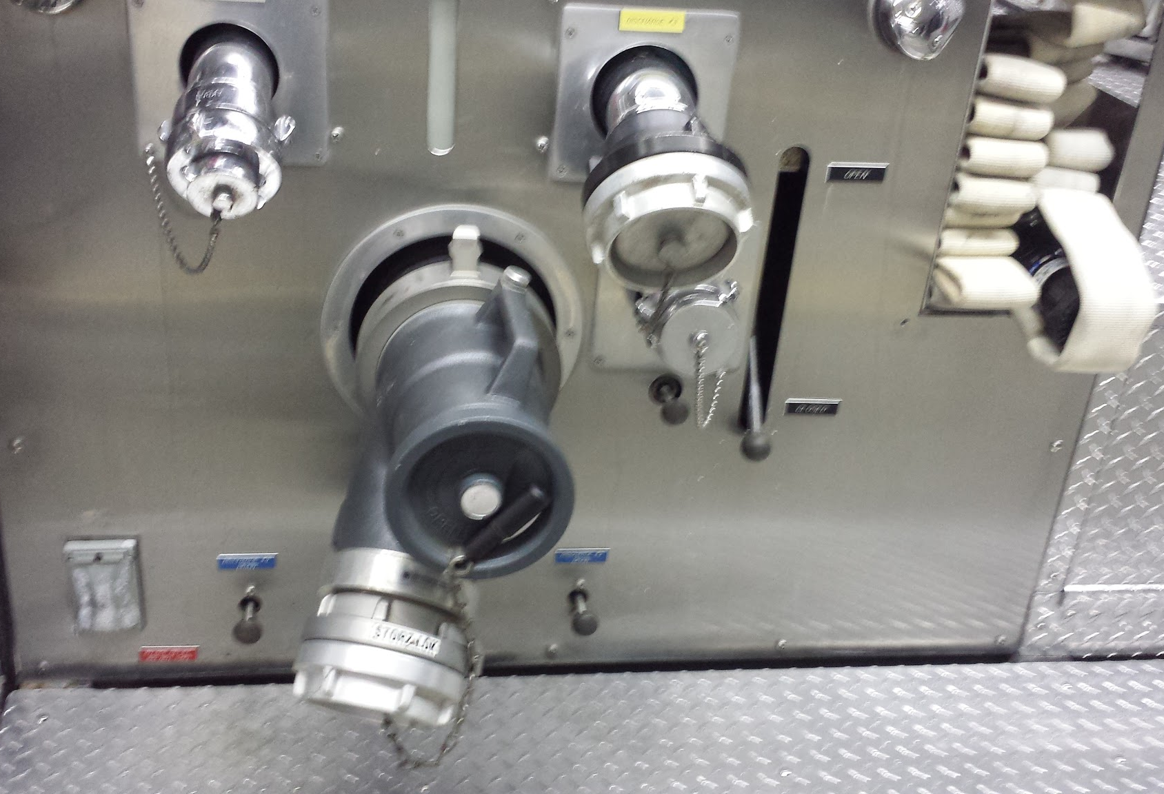
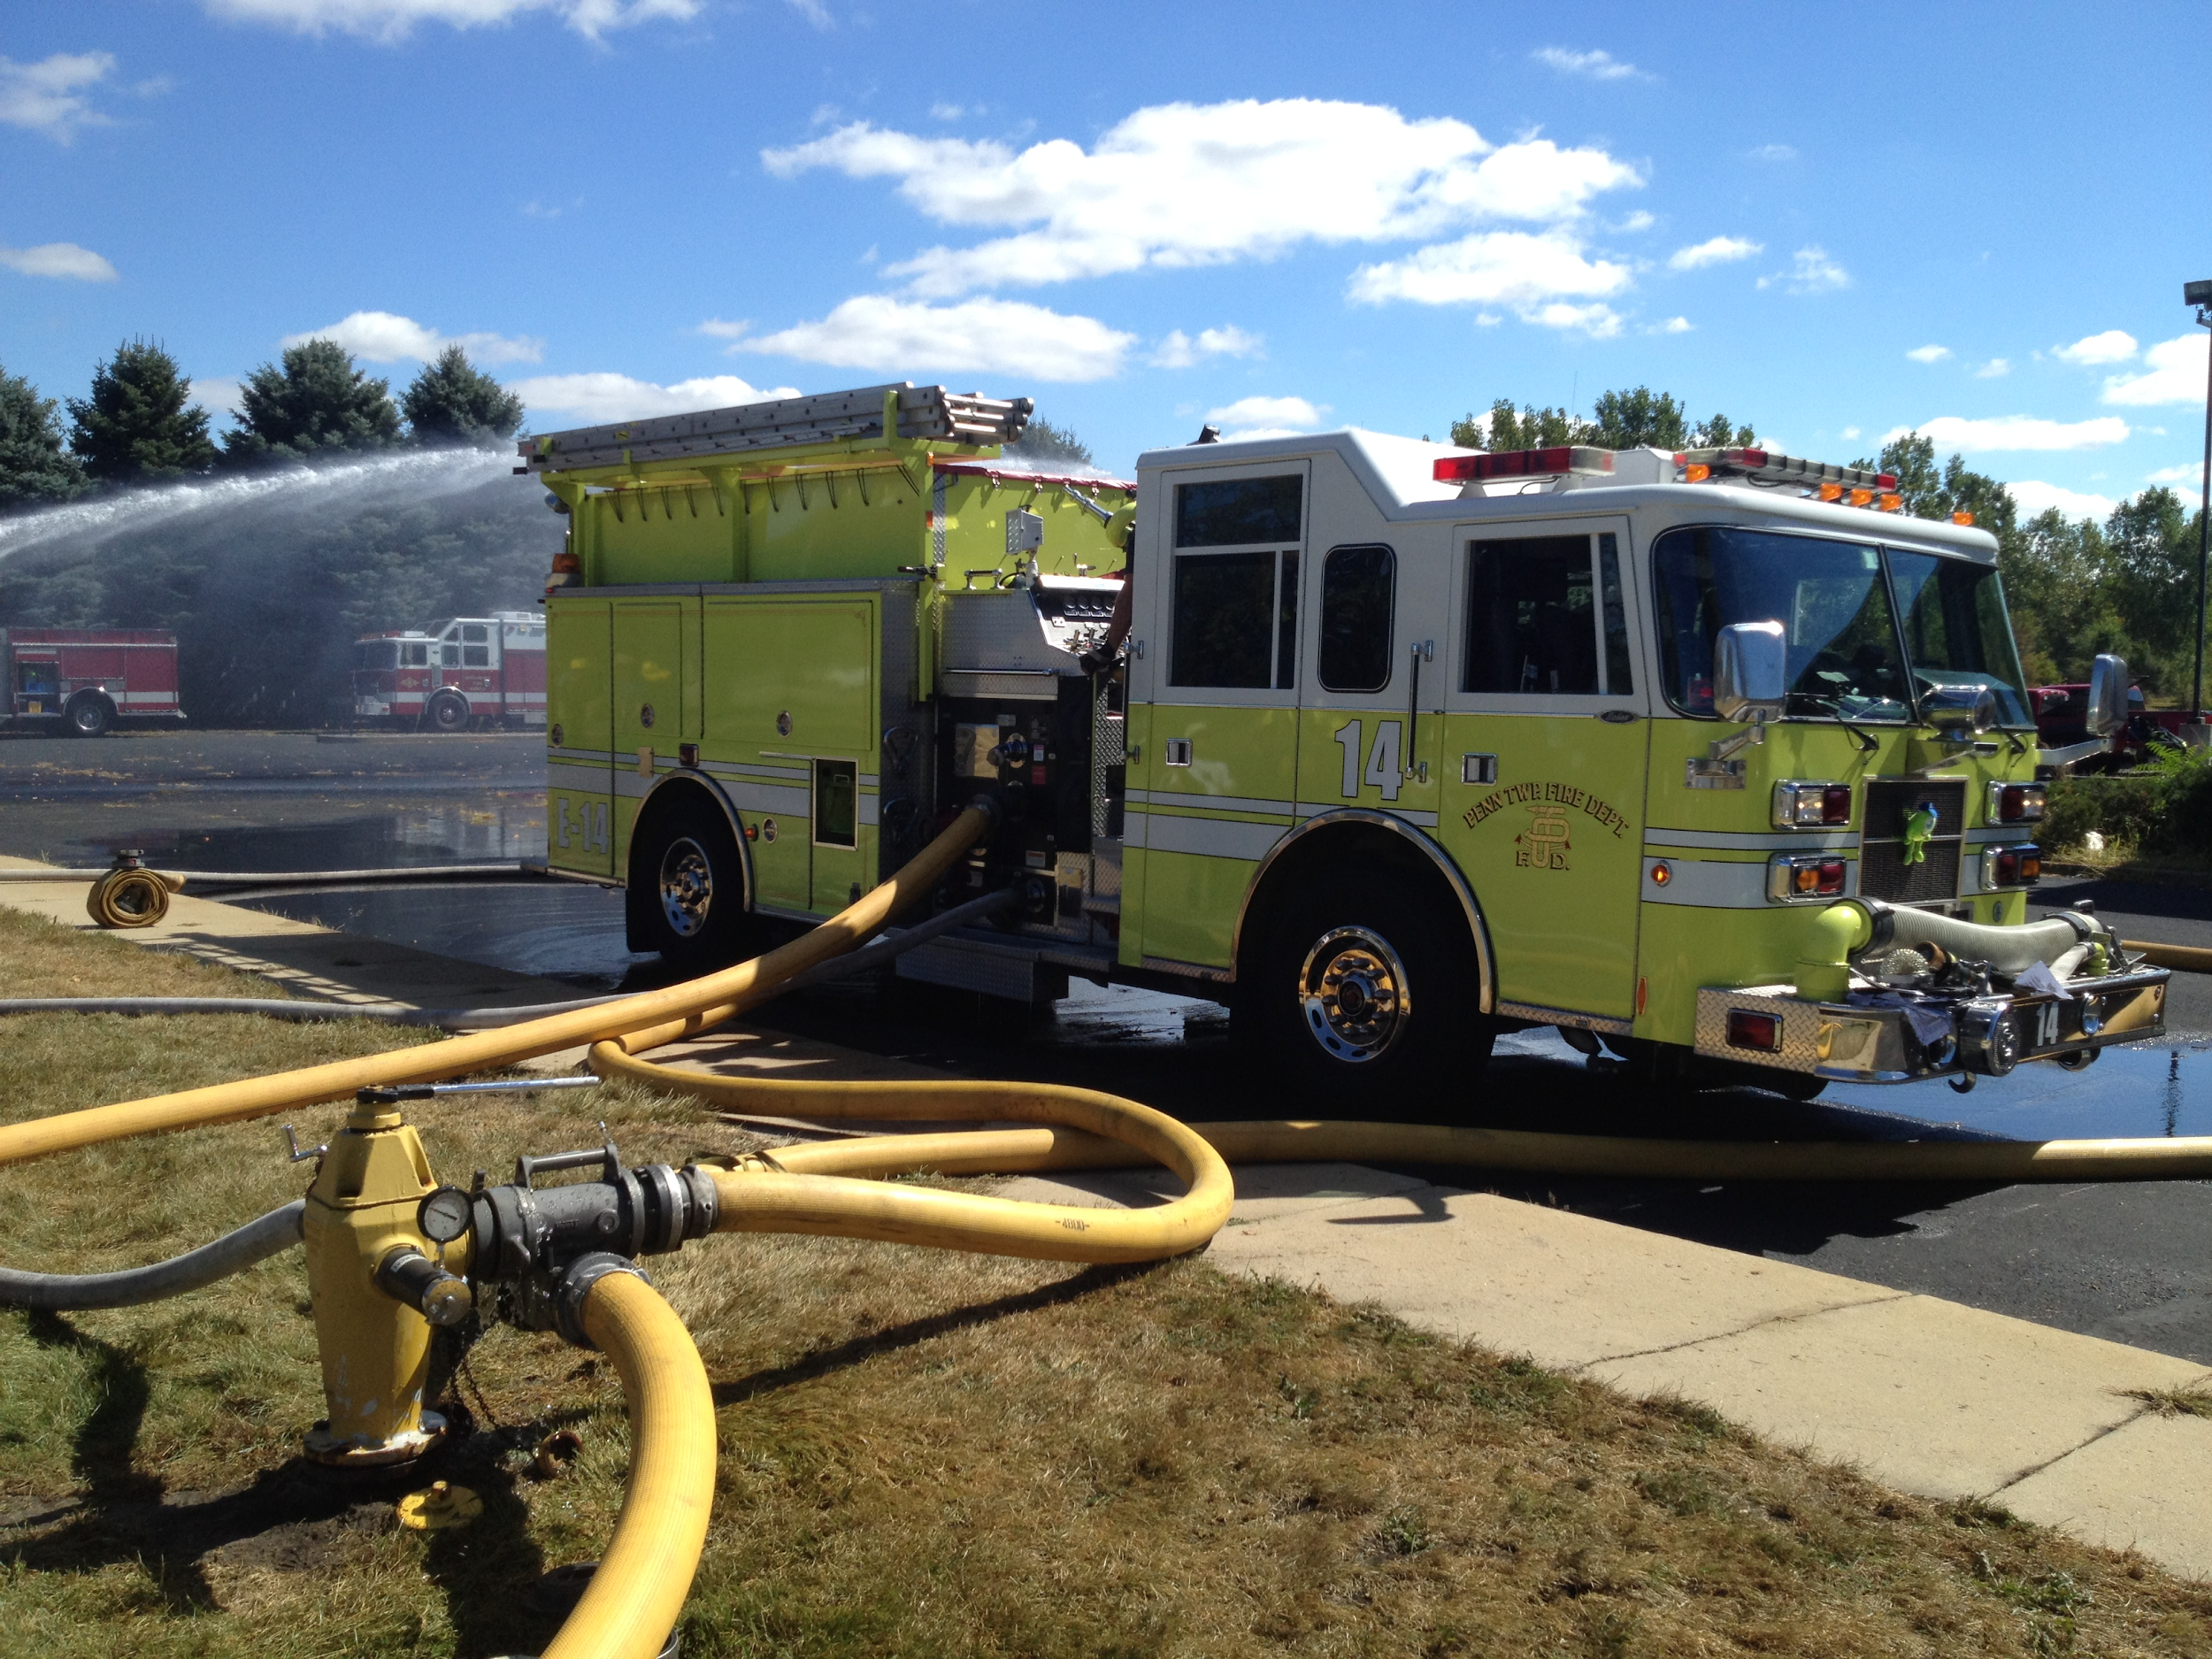
The Firefighter’s Situation
http://websites.firecompanies.com/pennfire/files/2013/09/HUMAT-1.jpg
Notes:
M
Left picture: Matt’s
Right picture: http://websites.firecompanies.com/pennfire/files/2013/09/HUMAT-1.jpg During a residential or commercial fire, multiple firetrucks may arrive at the scene. The firefighters will connect the truck to the closest available fire hydrant. The truck will
pump the water either down the attack lines that the firefighters will use, or to another truck which will do the same.
When the firefighters go to actually combat the fire, they will take the attack line from the side of the truck (pictured on the left). They will then enter the building in a small team of typically 2 or 3

Slide 4
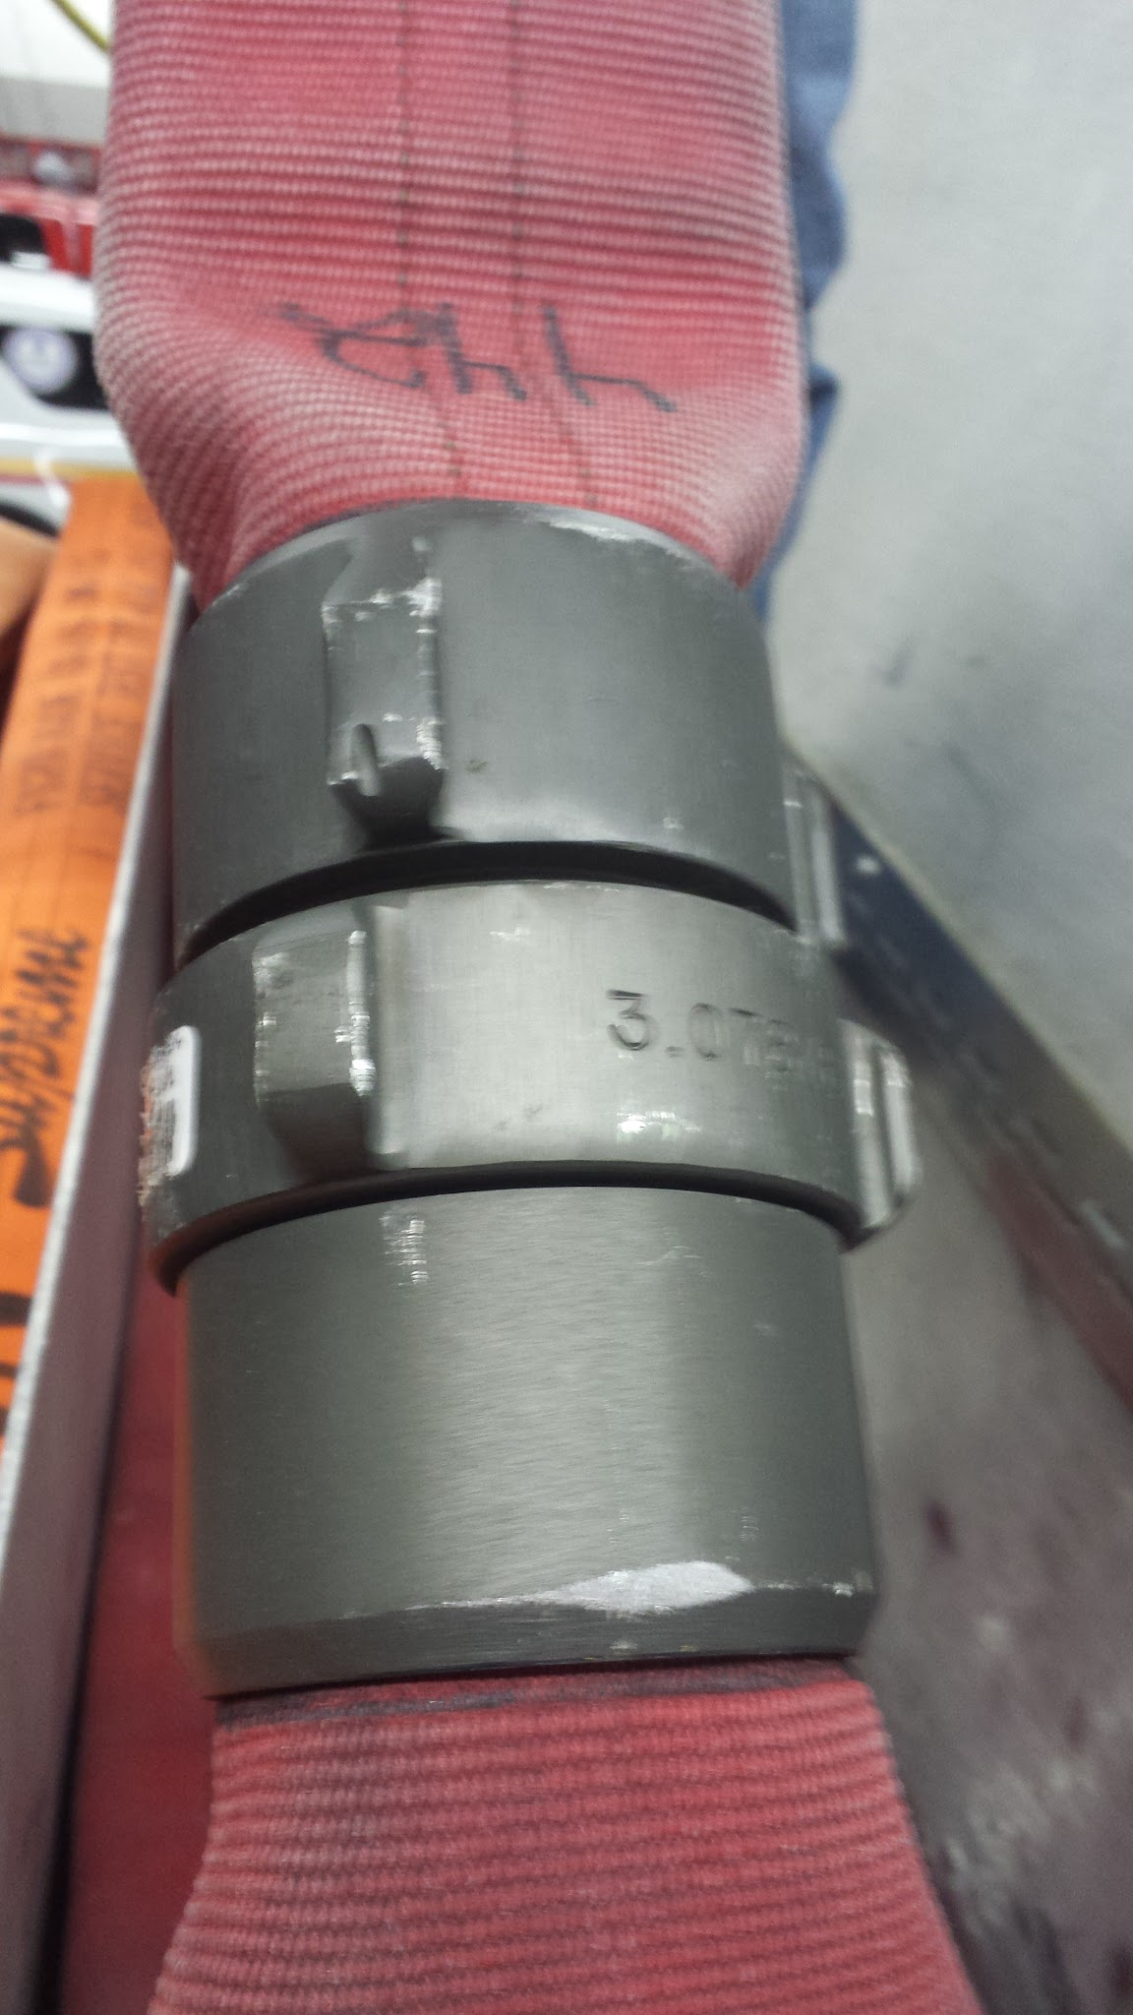
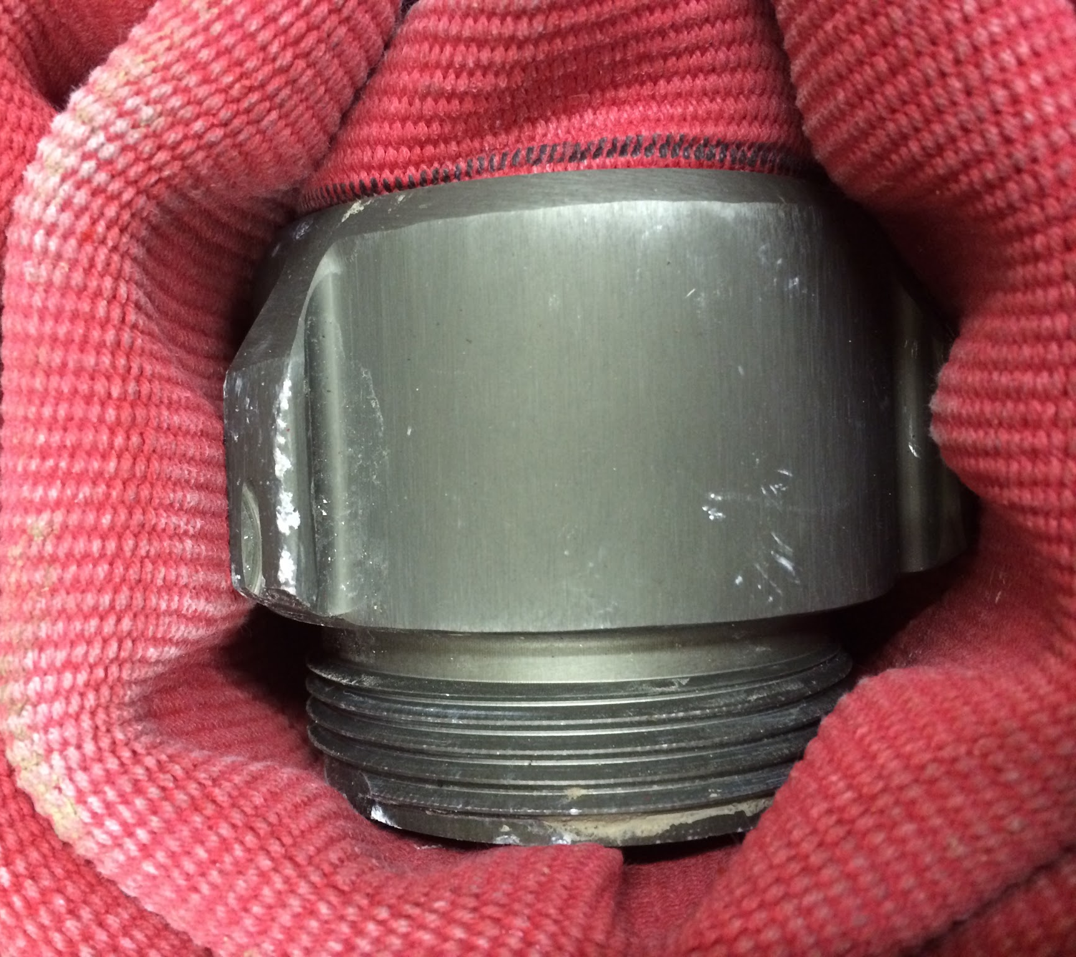
Attack Line/Coupler
Notes:
M
The attack line is made of segments fifty feet long connected by these couplers.
These are pictures of an upclose view of the couplers on an attack line which we took while visiting Kearsarge Fire Department to gather research on the topic.

Slide 5
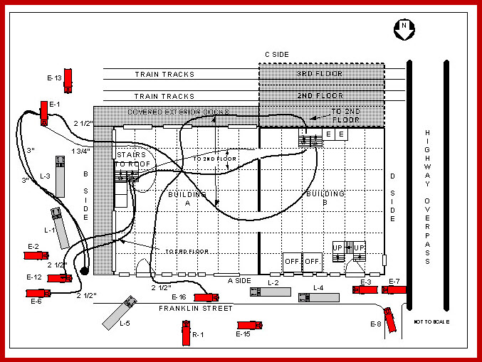
The Firefighter’s Situation
http://buildingsonfire.com/tag/command-compression/feed
Notes:
M
http://buildingsonfire.com/tag/command-compression/feed
For example, say you are a firefighter on truck e-1 pulling up to the scene of the fire. You and 2 other firefighters will grab your attack line and enter the building. While you are doing this there are also other teams moving upstairs from other trucks as well as another team from your own truck. After you reach the second floor, you may see something similar to this: **queue next slide**

Slide 6
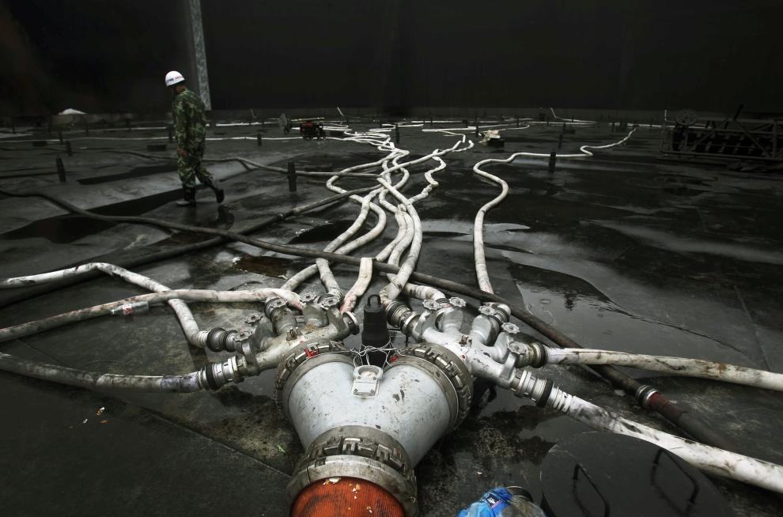
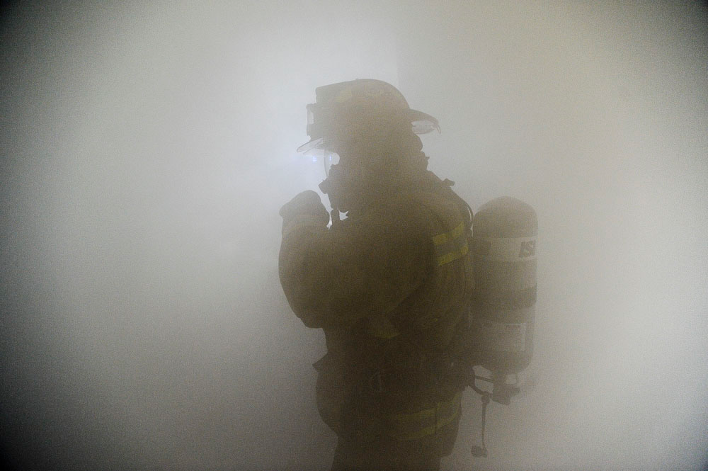
The Firefighter’s Situation
https://armyphoto.files.wordpress.com/2009/08/fire1.jpg
http://www.990px.pl/index.php/2010/07/26/skazenie-ropa/
Notes:
M
The hoses are from http://www.990px.pl/index.php/2010/07/26/skazenie-ropa/
Find either different smoke picture or find source: https://armyphoto.files.wordpress.com/2009/08/fire1.jpg
This entanglement of attack lines makes it difficult for firefighters to find where they are going during a fire. They may be trying to head toward the front of the hose to relieve the group currently manning it. They could also be the ones currently relieved and just trying to find their way out of the fire and back to the truck. During this time, if the wrong attack line is followed, the firefighter must retrace their steps and start again from the beginning. And keep in mind that this is during a fire. The environment could be extremely hot and smokey which can make it even more difficult to see what they are doing. Firefighters also wear thick gloves which only makes it harder to follow the hoses. But most importantly firefighters only have a limited amount of air to work with. Lost time is lost air which could be the difference between life and death.
Lost Time = Lost Air = Dead. RIP

Slide 7
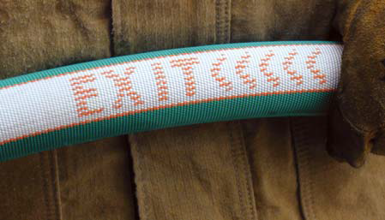
The Civilian Situation
http://www.lacountyfirefighters.org/items/Angus_Hose_Brochure.pdf
http://www.990px.pl/index.php/2010/07/26/skazenie-ropa/
Notes:
N
Setup situation for civilian.
For example: Thankfully, you wake up to the sound of your smoke detector going off. Your room is familiar, and becoming smokey you need to exit the building. You first hold your hand slightly away from the door knob to check for heat. Then you exit your room into the main building. You are immediately faced with the situation above. You see a mix of hoses. The most logical thing to do is to follow it. They will either lead you to firefighters( who are wearing protective gear) at the end of the line, or they will lead you to safety. Hoses also can lead you nowhere, the hoses are connected through the entire house. One hose may have traveled through a now, unsafe location.
Add a small grey but transparent thing over hoses “smokey room”
Then black pictures out almost. “dark and smokey room”
Describe the problem with these situations and how it is very important to not die.
Then transistion into the solutions to the problem (which suck)
Lost Time = Increased Danger (More smoke in lungs)

Slide 8
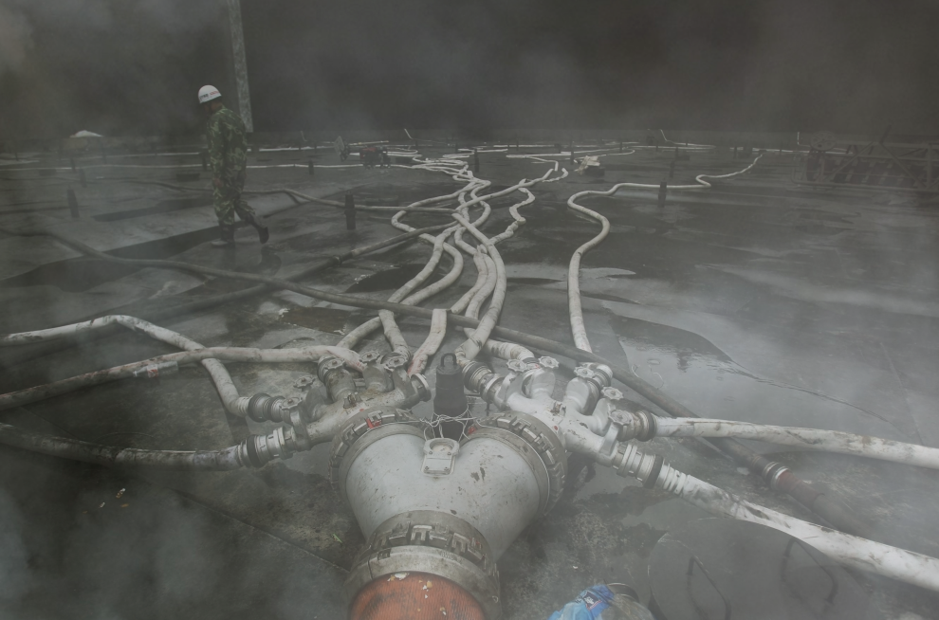
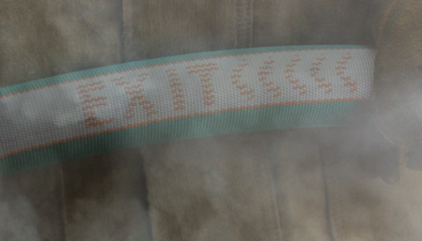
The Civilian Situation
Notes:
N
Smokey.
Same example but let us say you are on the outer edge of the smoke/fire. It becomes increasing more difficult to determine which way the exit is even with the exit printed on the hose.

Slide 9
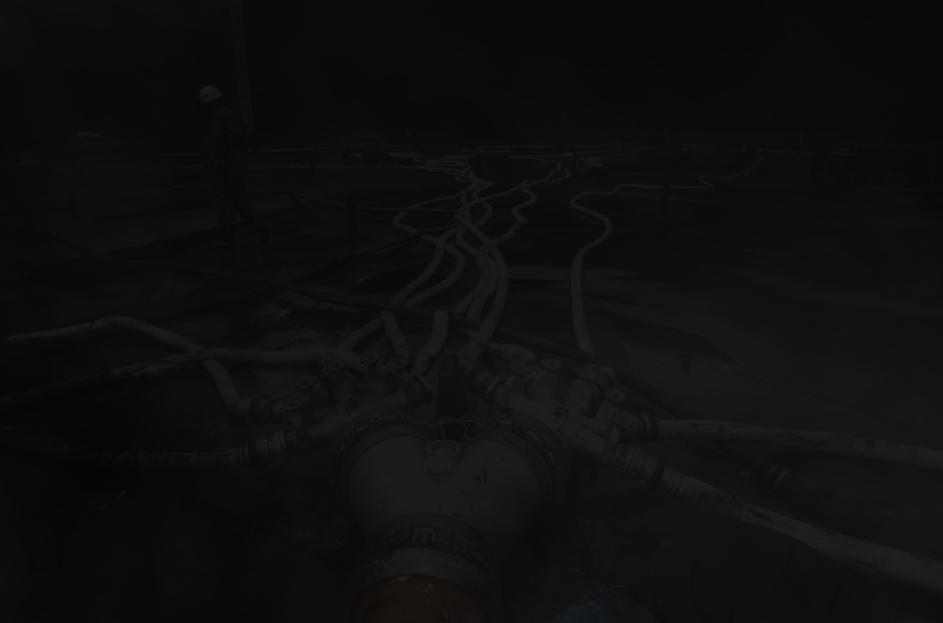
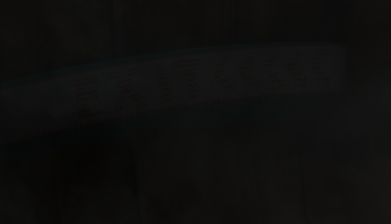
The Civilian Situation
Notes:
N
Blacked Out.
Once again let us look at the same example but now you are really close to the fire, you can not tell which way is out. the exit marking is practically invisible. This is the worst case, even if you can see the attack line how do you know which way is safe to travel and which way is hazardous.

Slide 10
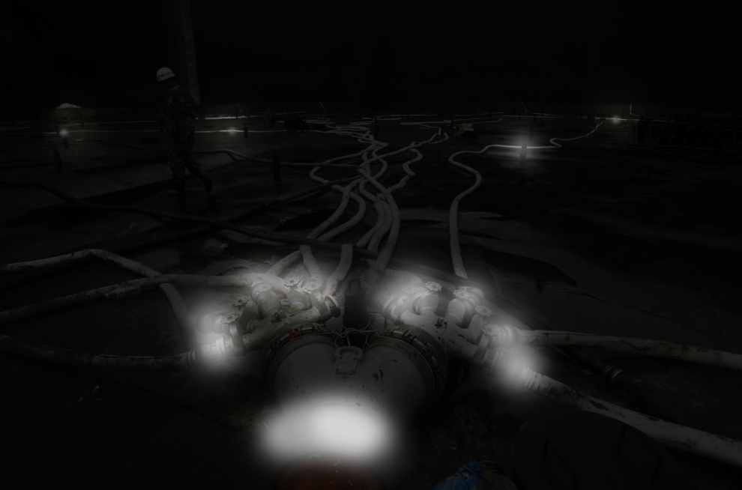
With the Coupler Lighting and Communication Device
Notes:
N
Following the hose becomes incredibly easy and you can find the correct path

Slide 11
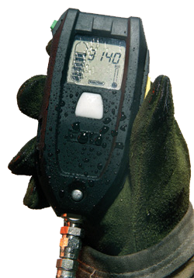
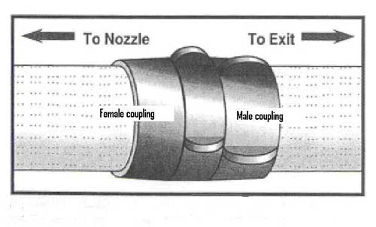
Existing Solutions
Little to Big, Back to the Rig
Big to Little Leads to the Middle
Motion Sensor
“PASS”
http://www.amherstfirefighters.org/pics/equip/equip03.jpg
http://www.cdc.gov/niosh/fire/reports/face200712.html
Notes:
C
http://www.cdc.gov/niosh/fire/reports/face200712.html
other than the attack line with the word exit and arrows printed on it, this is what you are looking at for current technology.
the leftmost picture is what the firefighters currently use to determine which way they are running towards. Most people do not know that the female end of the attack line is connected to the truck creating a pattern that goes f-m-f-m-...-f-m-nozzle so the female end always points to the front of the attack line while the male side points towards the truck. keep in mind that firefighters wear thick gloves which can make finding the right end difficult. the center picture is a motion sensor and it is a part of the firefighter’s air tank(MSA). This device has a panic button on it as well as it senses motion. If a firefighter does not respond to its constant warning it makes a loud noise signalling to the other firefighters that he is down.
*need source for msa*

Slide 12
Project Requirements
The device should automatically turn on/off
The device’s light should be visible from a distance of 30 feet
The device must be compatible with the Fire Code Standard 3 inch attack line
The device must not alter the attack line itself to avoid the need for recertification (i.e. the hose must still be able to fold and the water pressure should not be changed)
If possible, the device should harness energy from the hose or local environment
The device must be robust and survive in the heat and water produced by the environment
Reliable communication between individual couplers and truck
Notes:
N[intro+1,4,7] C[2,5] M[3,6]
Not really much to say here. Attempt to justify every reason: 1. Ain’t nobody got time for that. Firefighters don’t have time to plug stuff in or fiddle with a system. Fires burn hot fast and quick, time is valuable. etc.
2. 30 ft is the approximate length of a room. The device should be visible at that length in order for firefighters to see the links between rooms.
3. The hose has to remain up to code
4.The point of this project is to make an object that can be slapped onto a hose and be used by a fire house
5. This way batteries will not have to be changed
6. The environment that the coupler is going to be in is harsh and it has to be able to endure that
7.It is a life or death situation, kind of important that it is reliable

Slide 13
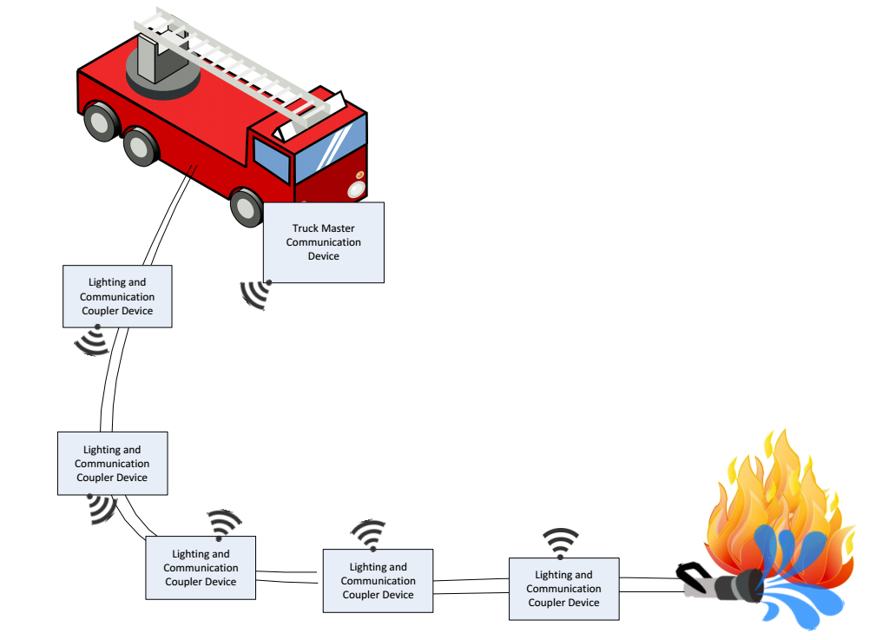
Level -1 Architecture
Device Integration into
Existing System
Notes:
Cody
This is a diagram of how our system would work with the existing system. Essentially, this adds major functionally to the existing system. Without making the system overly complicated.

Slide 14
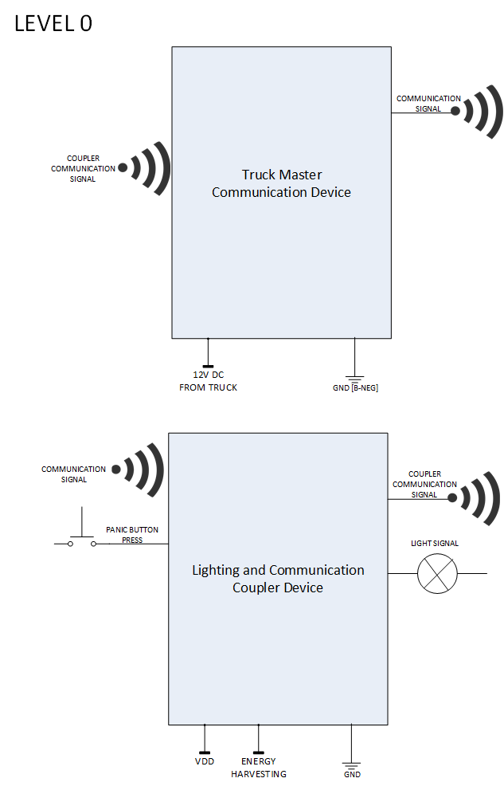
Level -0 Architecture
Notes:
Cody

Slide 15
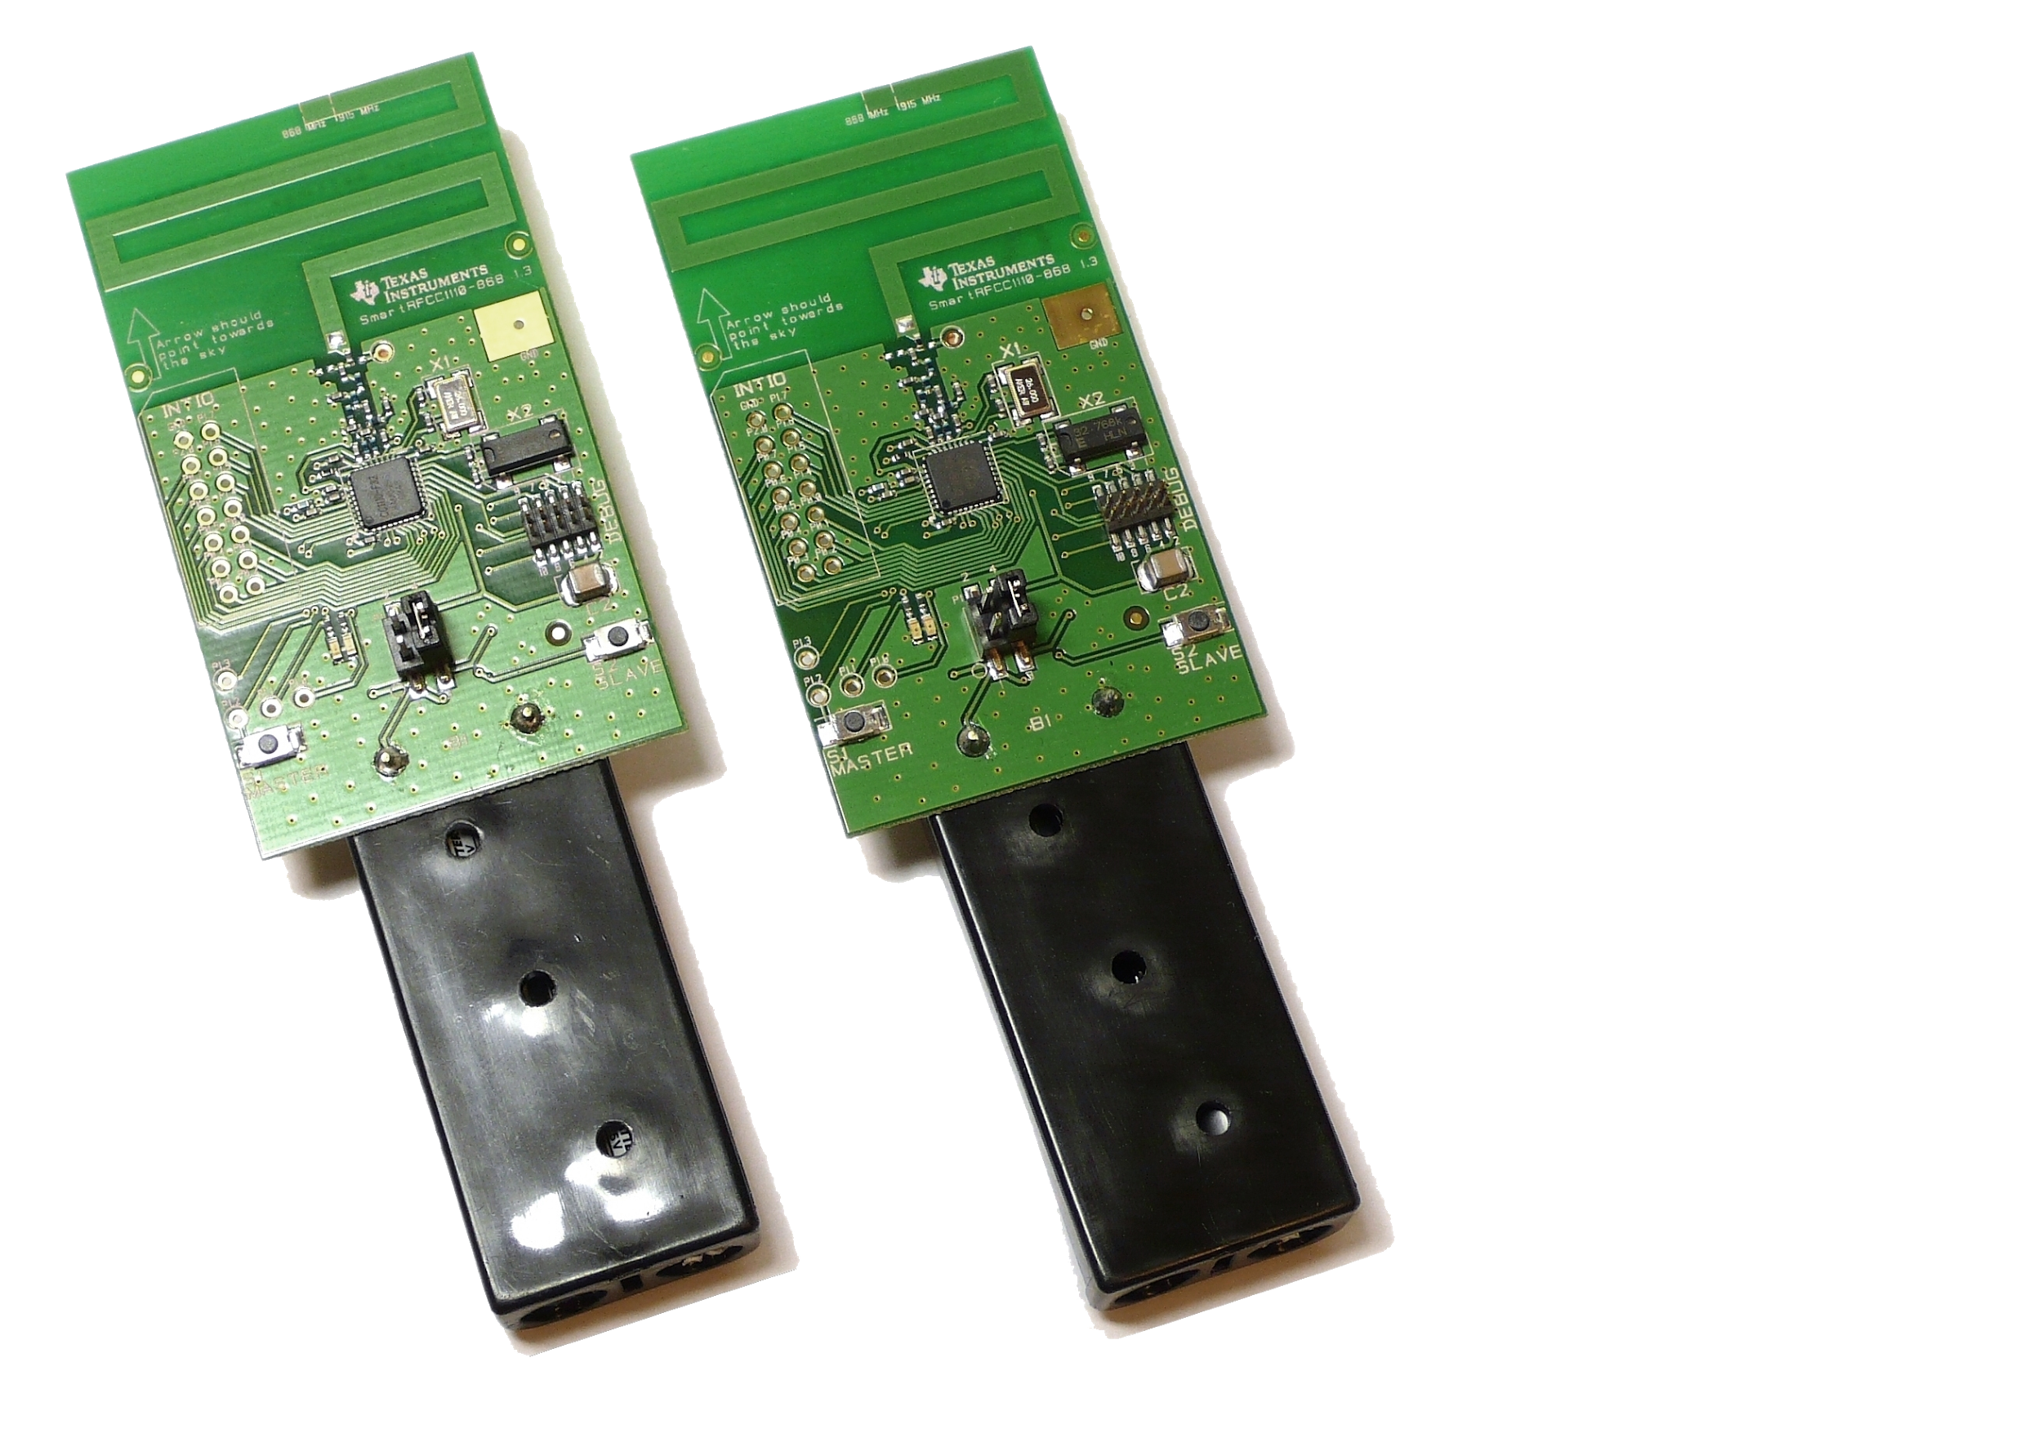
Wireless Communication
& Computation
CC1110
Low Power
Plenty of I/O
RF
Mesh Network
Unique Message Encoding
Network Storm Prevention
Notes:
C
*need source for xbee*
Xbee:
Low data rate (250kbit/s) and low power consumption.
Used to make mesh-type sensor networks; each XBee device can communication with each other, and through each other via the mesh to devices that are out of range.
Used for networks of devices, particular home automation and sensors.
Bluetooth
The maximum range that it offers is 100 meters,
The processing power and battery power that it requires in order to operate is very low
Simplicity – the radio is based on the familiar Classic Bluetooth radio, and its simple mode of operation can be managed by a small protocol stack
Low power – the radio is designed to spend nearly all of the time in power-down mode, drawing a negligible current - even in active transmit mode it draws a low peak current, which suits operation on a small battery
Robust radio – designers can target a line-of-sight range of as much as 100m. A frequency-hopping scheme makes a Bluetooth LE radio highly resistant to interference at its 2.4GHz licence-free band
Real-time operation – a connection between a node and a master device can be made, data transferred and the connection shut down, in just 3ms
Compatibility – Bluetooth is by far the best known personal area networking technology in the world, and is backed by all the main manufacturers of consumer devices.
Very low data rate and very low power.
These RF chips can run for years on an AA battery and so are used for things like heart rate sensors.
The data rate is quite low so only good for transferring a small amount of data such as sensor readings. Most devices are setup as peripherals and can only connect to one 'central' device, so no good for sensor networks.
Bluetooth low energy is supported by the latest mobile phones and laptops however.
Useful to enable control of a device using a phone or laptop, for example a LED lamp. (See redbearlab for some Arduino options)
RF Signal Pros
Relatively long range, up to 20 miles when line-of-sight is possible
License-free operation (only for 802.11-based systems)
Good operation in haze and foggy conditions, except heavy rain causes poor performance
High data rate (54Mbit/s +)
RF Signal Cons
High potential for RF interference from other external RF-based systems
Lower throughput, up to the Mbps range
Limited security because of radio propagation to beyond the facilities
High power consumption
Used when you need to connect directly to the internet, such as an internet-of-things device, and have an external power source.
Naghian, S., "Mesh vs. point-to-multipoint topology: a coverage and spectrum efficiency comparison," in Personal, Indoor and Mobile Radio Communications, 2004. PIMRC 2004. 15th IEEE International Symposium on , vol.2, no., pp.1048-1051 Vol.2, 5-8 Sept. 2004
doi: 10.1109/PIMRC.2004.1373858
URL: http://ieeexplore.ieee.org/stamp/stamp.jsp?tp=&arnumber=1373858&isnumber=29981
Mesh:
At the same time that every new node increases the coverage for potential newcomers, the existing can he optimized.
When the network becomes denser the hop lengths will, on average, become shorter because more multihop connections can be applied.
As a consequence, transmit power levels can be decreased accordingly or the modulation method can he changed to increase hop capacity.
Theoretically, in a mesh topology, the coverage probability increases rapidly as the number of nodes in the mesh cluster increases and makes the turning up of new low loss paths more and more probable for new nodes.
In reality, the probability of reliable link between any two points is not typically equal but depends on sed system parameters; transmit power, antenna gains and receiver sensitivity.
It is also affected by the ttenuation of a link depending on distance between the two points and antennas heights.
PTP:
Direct connection
Use all bandwidth until the hops begin to get farther.
Transmission through objects
USB style
1 connection between 2 nodes

Slide 16
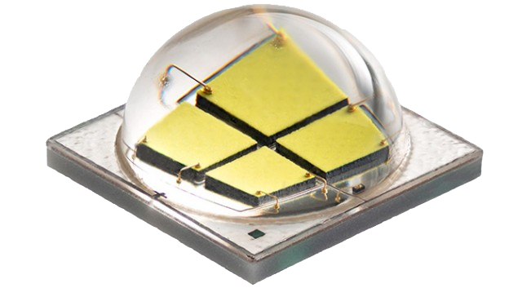
Lighting
CREE LED
Tri-Color LED
Power Hungry
http://www.extremetech.com/wp-content/uploads/2012/12/200lpw-640x353.jpg
Notes:
M
To light our device, we decided on using Cree XLamp LEDs.
They have a high light output, maximum power efficiency, and a very long life span (if left on for 24 hrs/day will last over 5 years)
Another option we were considering was using tri-color LEDs. These would provide us with colors other than white which could be used to distinguish attack lines between different trucks, However, the tri-color LEDs proved to use too much power for our budget and constraints so we opted with the more efficient and brighter CREE LEDs.
The light can be lit for only a fraction of the time also to save even more power. Our device blinks steadily to provide visibility and blinks at a faster rate to signify that a coupler panic button somewhere on the line has been set.
CREE LED - Very bright, long term luminous intensity and long life span (typically around 25k hours until < 70% intensity) <- over 5 years if 24hrs/day
Tri-Color LED - Multiple colors can be used to distinguish hoses from various trucks (can also make secondary colors by switching quickly between colors)
Neon Lamp - Very low power consumption, very long life span (upwards of 10 years)
Laser - Focused beam, smoke in environment makes laser more visible because it bounces off particles in air
If we must choose only one color, we will probably use green because it is in the center of the human visibility spectrum and our eyes are most sensitive to it. Also nothing else in the surrounding area should be emitting any green light (fire = red)
Also if one color, we can distinguish between the trucks by blinking different patterns
http://www.damngeeky.com/2012/10/18/6301/arrow-gas-mask-with-laser-guided-sign-shows-exit-path-in-dense-smoke.html
http://florin.myip.org/blog/how-build-small-laser-can-burn-things
http://www.extremetech.com/electronics/143672-cree-releases-landmark-200-lumen-per-watt-led

Slide 17
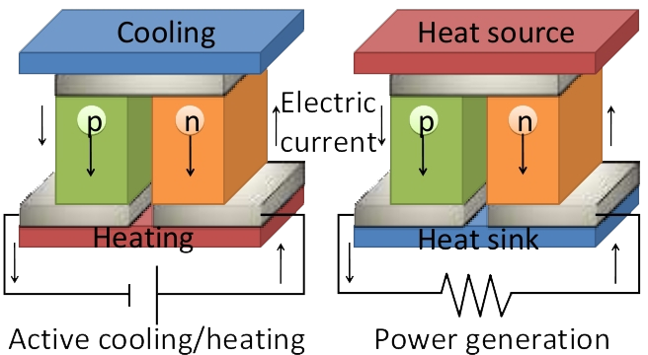
Energy Harvesting
Thermoelectric properties
http://gibbs.uio.no/nks/Bilder/fig_ole_martin.jpg
Notes:
N
long life span since there are no moving parts or materials which must be replenished
Piezoelectric - Mechanically deforming a piezo crystal with tension or pressure generates electrical charges that can be measured as voltage on the electrodes of the piezo element.
Resilient, resistant to high temperatures
Thermoelectric power is the conversion of a temperature differential directly into electrical power. Thermoelectric power results primarily from two physical effects: the Seebeck effect, and Peltier effect.
seebeck effect -> is a phenomenon in which a temperature difference between two dissimilar electrical conductors or semiconductors produces a voltage difference between the two substances.
Peltier effect -> is a temperature difference created by applying a voltage between two electrodes connected to a sample of semiconductor material
Solar Power - We would use solar power to charge a battery while there is no fire going on or if there is a fire going on in the day
very low maintenance beyond occasional cleaning if necessary however the firefighters have to clean the hose off anyways after a fire so that should not be much of an issue

Slide 18
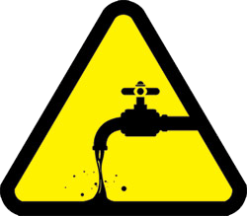
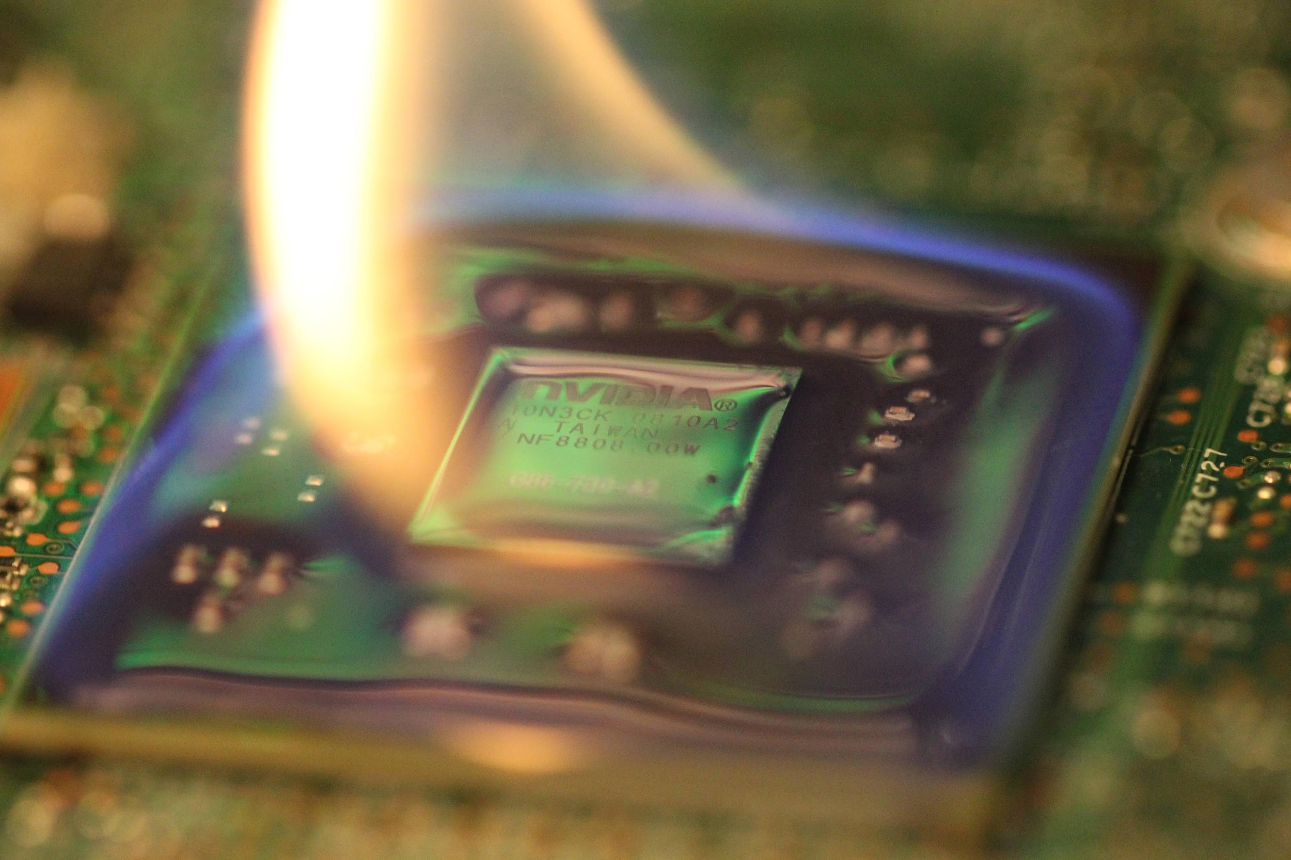
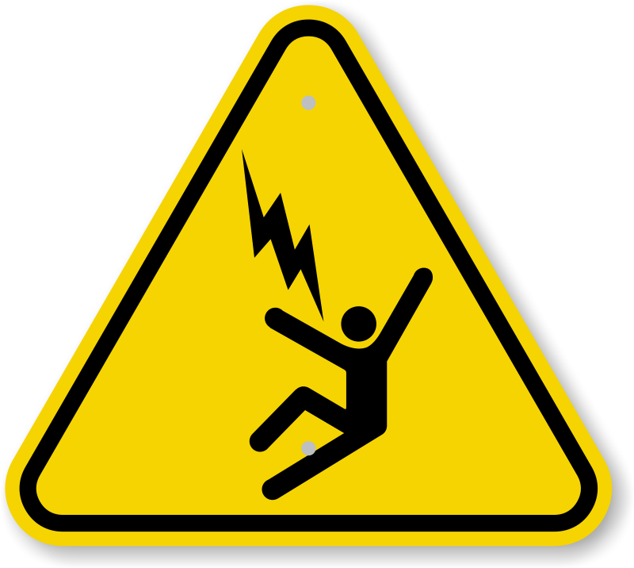
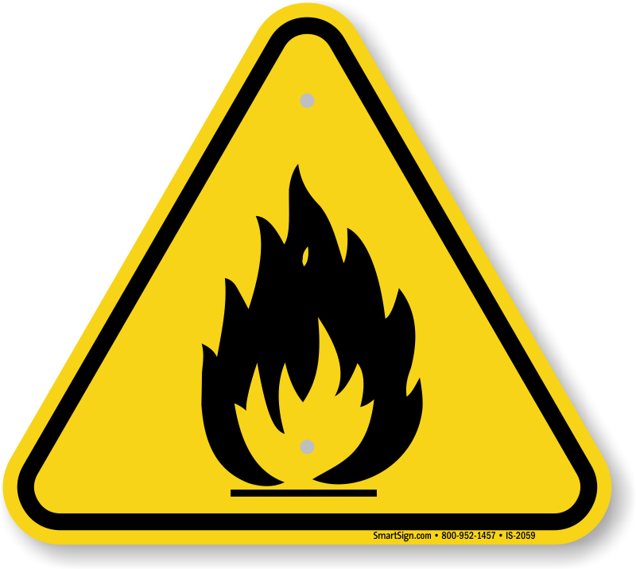
Environmental Resistances
Ingress Protection Rating (IP-67)
Rubber sealant
Vespel Engineering Plastic
Aerogel
http://www.mydoorsign.com/img/lg/I/iso-electrocution-voltage-hazard-symbol-is-2029.png
http://www.freedrinkingwater.com/water-education3/32-water-tab-water.htm
http://cliparts.co/clipart/952959
https://i.imgur.com/yhUFZTk.jpg
Notes:
C
IPR:
http://assets.bluesea.com/files/resources/technical_briefs/IPChart_diagram.pdf
Rubber:
Flexible, durable, heat tolerant, and
Flexseal plasti dip
Vespel:
It is one of the most commonly used engineering plastics in the aerospace industry. Virtually every jet engine made in the Western World contains Vespel® parts. It is also the material of choice in the manufacture of semiconductors and in transportation applications. Vespel® parts can endure extreme environments from reactor chambers to deep space.
Vespel® is available in an unfilled grade as well as in filled grades with various percentages of graphite, PTFE/graphite or molybdenum disulfide. The unfilled grade is often referred to as SP1. We will discuss the characteristics of that grade here.
Thermal Properties: Vespel® SP1 is a semi-crystalline material thus it has a structure that has both crystalline and amorphous regions. Consequently is has no melting point but unlike other semi-crystalline plastics it also has no observable glass transition temperature below its decomposition temperature of more than 750/400 ⁰F/⁰C. Vespel® SP1 has a maximum continuous service temperature of 500/260 ⁰F/⁰C but can tolerate temperatures of as high as 900/482 ⁰ F/⁰C for a short period of time without loss of its mechanical properties. It is no surprise then that SP1 has a flammability rating of UL 94 V-0 and is flame retardant.
Vespel® SP1 has a low co-efficient of friction.
SP1 allows for significant weight savings over metal parts and thus improves fuel efficiency. It has one half the weight of cast aluminum.
Aerogel:
PHYSICAL AND CHEMICAL PROPERTIES
Appearance
Form Monolithic solid
Color Transparent blue to white
Materials Data
Solubility in Water Insoluble
Density 0.020 – 0.100 g cm-3
pH Not applicable
Odor No characteristic odor
Sintering Point 600 – 800°C
Melting Point >1600°C
Boiling Point 2230°C
http://www.mydoorsign.com/img/lg/I/iso-electrocution-voltage-hazard-symbol-is-2029.png
http://www.freedrinkingwater.com/water-education3/32-water-tab-water.htm
http://cliparts.co/clipart/952959

Slide 19
Project Completion
Complete:
Robust Communication Established
Truck Master I/O
Lighting and Communication Coupler User I/O
Energy Harvesting Unit
Requires Additional Work:
Finalizing Enclosure Design
Finalizing Power Delivery System
Accelerometer
Unique Color for Lighting
Notes:
Cody & Nick(im a going to talk about the accelerometer&uniques color for lighting) & Matt

Slide 20
Future Project Insight
Concluding Thoughts Lessons Learned
Energy Harvesting
TEG
Fragile & High Power Output
Robust & Low Power Output
Hybridization
Power Delivery
Smart Switching Power Supply
Lighting
Color
LEDs = Bright
LEDs =/= Power Efficient
Accelerometer
Panic Mode
Button OR ___
Enclosure
Shock Resistance
Flame Retardancy
Waterproofing
Exposure for TEG
Cost Metrics
Microcontroller
Price & Performance = Awesome
Notes:
Cody & Matt & Nick (enclosure&mcu)

Slide 21
Thank You Questions?

